Slide 1

SMART INDIA HACKATHON 2026
TITLE PAGE
PROBLEM STATEMENT ID – SIH26172
PROBLEM STATEMENT TITLE - LOW LATENCY AND
EFFICIENT VOICE ACTIVATOR FOR EDGE DEVICES
THEME- SMART AUTOMATION
PS CATEGORY- HARDWARE
TEAM NAME-SIGNAL SEEKERS

Slide 2
TinyML Voice Activation for Edge IoT
Signal Seekers
PROPOSED SOLUTION
Wake-word + Command Detection Fully On-device On One ESP32-S3 Chip
Zero Cloud, Zero Network Delay, Zero Raw Audio Ever Leaves The Device
Novelty: Joint Optimization Of ULTRA LOW LATENCY + POWER + ACCURACY + MEMORY In One Pipeline
🎙 SPEAK
Say your custom wake word
🧠 DETECT ON-DEVICE
TinyML KWS on ESP32-S3
⚡ ACT INSTANTLY
Local command → IoT/GPIO
☁️ No raw audio is ever transmitted to the cloud
🔒
☁️
⚡
🔋
EFFICIENT/
low power
PRIVATE
CLOUD-FREE
FAST
@SIH Idea submission- Template

Slide 3
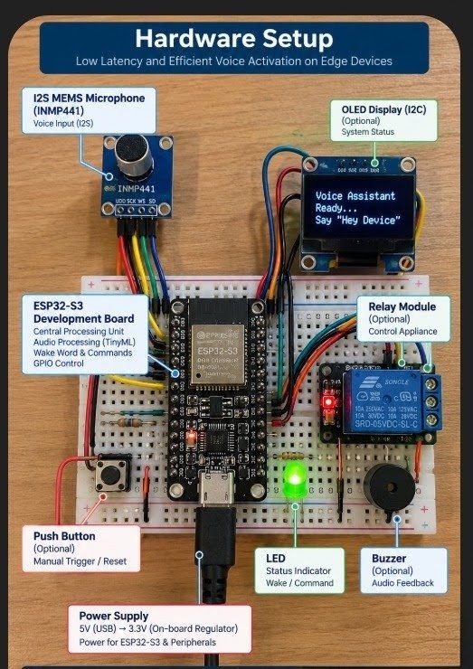
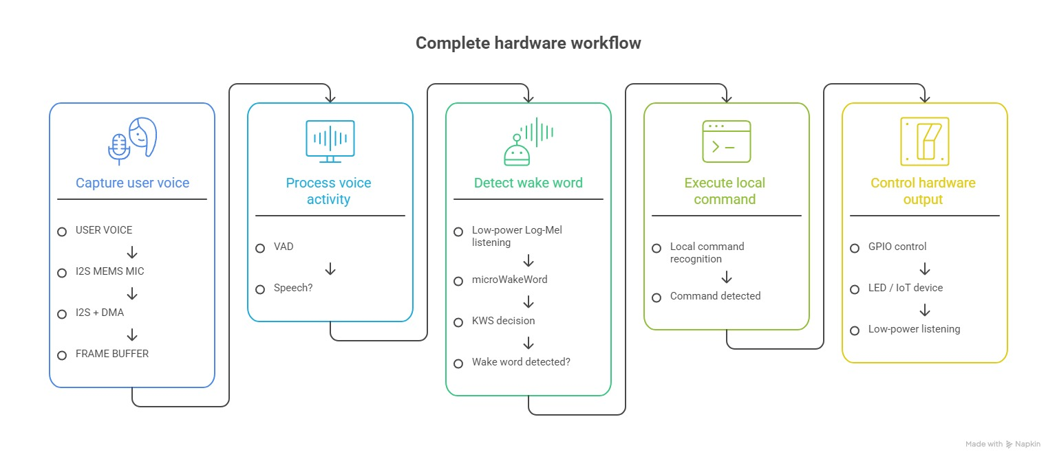
TECHNICAL APPROACH
Signal Seekers
Listen intelligently… Process efficiently... Respond instantly…
Adaptive edge processing combines lightweight audio analysis, TinyML wake-word detection, and local command execution for fast, fully offline voice activation.

Slide 4
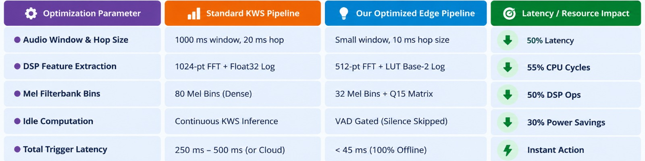
FEASIBILITY AND VIABILITY
Signal Seekers
Readily Available Hardware: ESP32-S3 + I2S MEMS microphone enables practical, low-cost implementation.
Open-Source & Offline: Uses open-source TinyML tools and requires no cloud/API dependency.
These directly support feasibility and viability
How Latency And Resource Usage Is Reduced By Our Solution

Slide 5
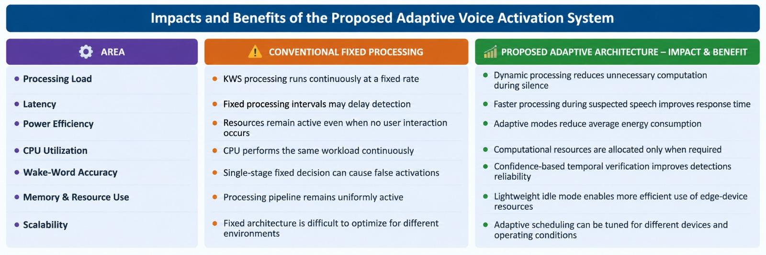
IMPACT AND BENEFITS
Signal Seekers
🚀 Gaganyaan: Potential hands-free onboard astronaut–system interaction.
🌕 Lunar/Planetary Missions: Local AI enables autonomous operation under communication constraints.
🛰️ Spacecraft & Rovers: Low-power edge intelligence reduces communication load and enables faster onboard decisions

Slide 6
RESEARCH AND REFERENCES
Signal Seekers
  https://drive.google.com/drive/folders/1l-33g6C0824NwfXdUlr6JkJh5BJXL5c9?usp=sharing
    Advances in Small-Footprint Keyword Spotting for TinyML: A Comprehensive Review of Efficient Models and Algorithms
    https://www.sciencedirect.com/science/article/pii/S0925231226014268
Hello Edge: Keyword Spotting on Microcontrollers
https://arxiv.org/abs/1711.07128
Hardware Acceleration for Embedded Keyword Spotting: Tutorial and Survey https://dl.acm.org/doi/10.1145/3474365
A 510-nW Wake-Up Keyword-Spotting Chip Using Serial-FFT-Based MFCC and Binarized Depthwise Separable CNN
https://scispace.com/papers/a-510-nw-wake-up-keyword-spotting-chip-using-serial-fft-3z0ajwmcf3
Key References
•
Espressif ESP32-S3 & ESP-IDF documentation
•
TensorFlow Lite for Microcontrollers (TinyML)
•
microWakeWord — open-source wake-word framework
•
Research on TinyML keyword spotting & Log-Mel features for MCUs

